Slide 1
Dissertation RP

Slide 2
Summary
Topic: Residential Segregation
Open Question: How different homophily preferences affect spatial segregation
Theoretical Framework: System Dynamics – Schelling
What is missing: definition of similarity in diverse societies
Rational Models
Paper 1: homophily preferences in Schelling threshold model
Paper 2: heterogeneous preferences in Schelling discrete choice model
Paper 3: integrationist and segregationist preferences
Conclusions
Limits and Future Research Venues

Slide 3
Residential Segregation
what it is
why important

Slide 4
Schelling Model
What it says
Contribution

Slide 5
Complexity
Agent-based modelling

Slide 6
But
Diverse Societies
Multiple categories

Slide 7
1st paper
A figure showing changes?
Extension to Schelling:
literature
Model
Experiments
Results
Limits and link to 2nd paper:
threshold deterministic model
strength of preferences
link to data

Slide 8
2nd paper
Extension to previous model:
literature
Model
Experiments
Results
Limits and link to 3rd paper:
linear function: tendency to segregation and spillover effects: need of different functions than linear
A figure showing changes?

Slide 9
3rd paper
A figure showing changes?
Extension to previous model:
literature
Model
Experiments
Results
Limits and Discussion

Slide 10
Conclusions
Pic comparing different formulations of the model
What changes compared to Schelling and how does it contribute to diverse societies
Overall results
Even though we define similarity on a cross-category, or some aim at integration, segregation always emerges as effect of interaction of people

Slide 11
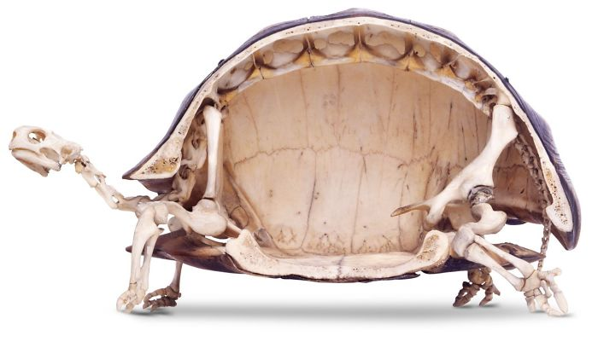
Discussion
Theretical model vs empirical models: now we know how different utility preferences generate segregation scenarios
We need theoretical, formal models for understanding complex phenomena
Notes:
https://www.wonews.it/immagine/lo-scheletro-di-una-tartaruga
As the skeleton of the turtle is embedded to its organism, so mechanisms are embedded to the phenomenon
What is the equivalent of initialization? Different races of turtles?

Slide 12
Limits and Future Research
As in Schelling, we do not know what could be the individual drivers of homophilic preferences
As in Schelling, the interest is how interaction of preferences translate into macro dynamics, no matter what drives individual preferences
Future: initialization of the model with socio-demographics and correlate with preferences estimated:
observed preferences? stated preferences? They all can have limit, and this doesn’t matter on the study of micro macro level
model of a specific system: context, or comparison of different contexts > need of a general abstract model, which provides insights for understanding mechanisms embedded in a context
More than 2 ethnic groups cohabit: this could have implication for the dynamics of the model > need to simplify the model and investigate its core mechanisms

Slide 13
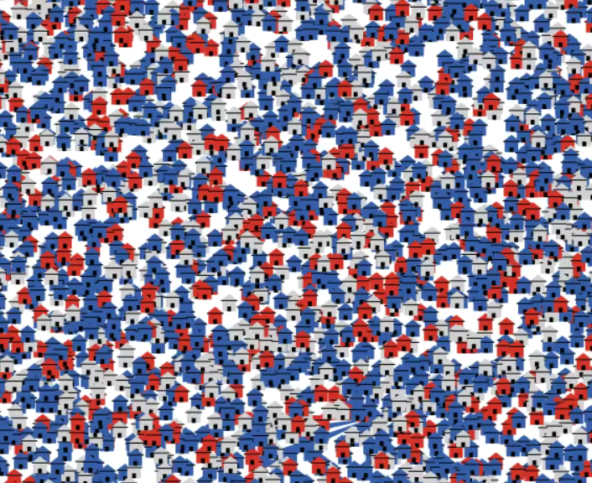
There is to drive, I hope to get the driving license
Questions? Feedback?

